Slide 1
Final Engagement
Attack, Defense & Analysis of a Vulnerable Network

Slide 2
Table of Contents
This document contains the following resources:
Network Topology & Critical Vulnerabilities
Exploits Used
Alerts Implemented
Malicious Network Activity

Slide 3

Network Topology
& Critical Vulnerabilities
3

Slide 4
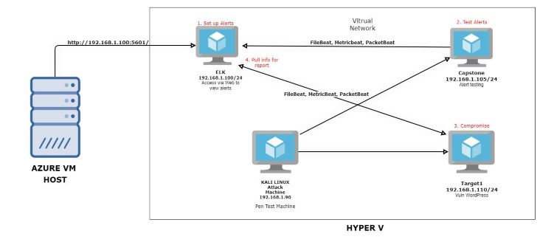
Network Topology
Network
Address Range: 192.168.1.0/24
Gateway: 192.168.1.1
Machines
IPv4: 192.168.1.110
OS: Linux
Hostname: Target 1
IPv4: 192.168.1.100
OS: Linux
Hostname: ELK
IPv4: 192.168.1.105
OS: Linux
Hostname: Capstone
IPv4: 192.168.1.90
OS: Kali Linux
Hostname: Kali

Slide 5
Critical Vulnerabilities: Target 1
Our assessment uncovered the following critical vulnerabilities in Target 1.
Vulnerability | Description | Impact
WordPress site User Enumeration | A technique used by malicious actors to obtain sensitive user information. | Depending on what information is stored, it could be vulnerability of high impact.
Weak Passwords | The user has a weak password that is either easy to crack, or easy to guess. | This would allow the malicious actor to gain access to the users account.
Python Privilege Escalation | A user has sudo privileges with python and through that, the actor is able to escalate from standard user to “root”. | By becoming root, the malicious actor is able to have near limitless access to the user's computer and network.
Password hashes in wordpress database | The user/company decided to store their hashed passwords within their wordpress database which would allow someone to get the passwords. | Having your passwords stored somewhere that can be accessed, leaves your organization open for a malicious actor to obtain them, crack them and subsequently gain access to your network.

Slide 6
Exploits Used
6

Slide 7
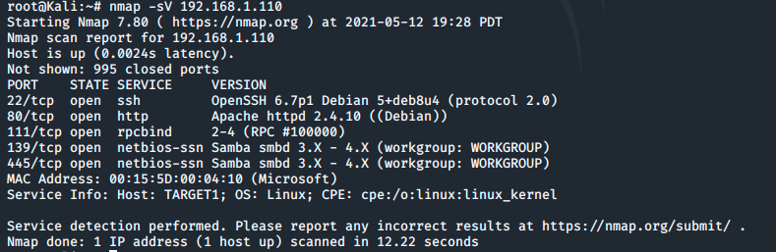
Exploitation: Vulnerable WordPress Server
Using nmap we found several machines on the network. We determined that the IP address 192.168.1.110 was a vulnerable target with several open ports we could exploit.

Slide 8
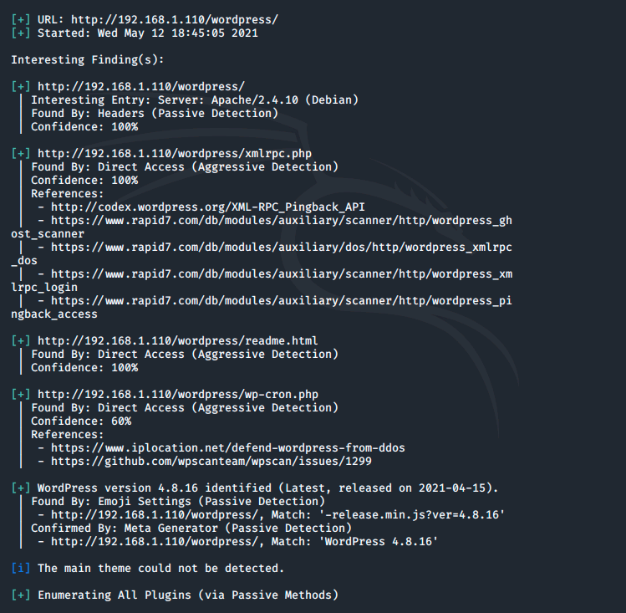
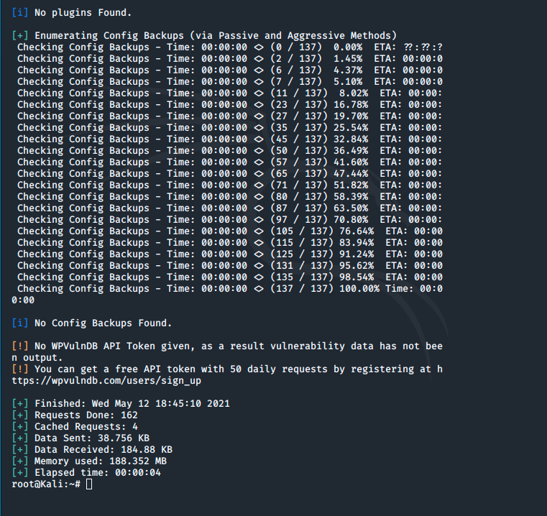
Exploitation: Vulnerable WordPress Server
Knowing the target host we were able to use wpscan to determine any potential vulnerabilities in the wordpress server we found on the host.

Slide 9
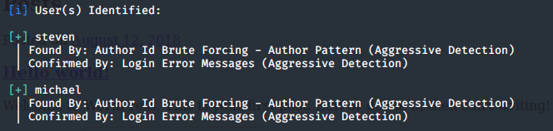
Exploitation: Vulnerable WordPress Server
Using the Enumerate Usernames function of wpscan we were able to find potential usernames for the WordPress Server.
wpscan --url http://192.168.1.110/wordpress/ --enumerate u

Slide 10
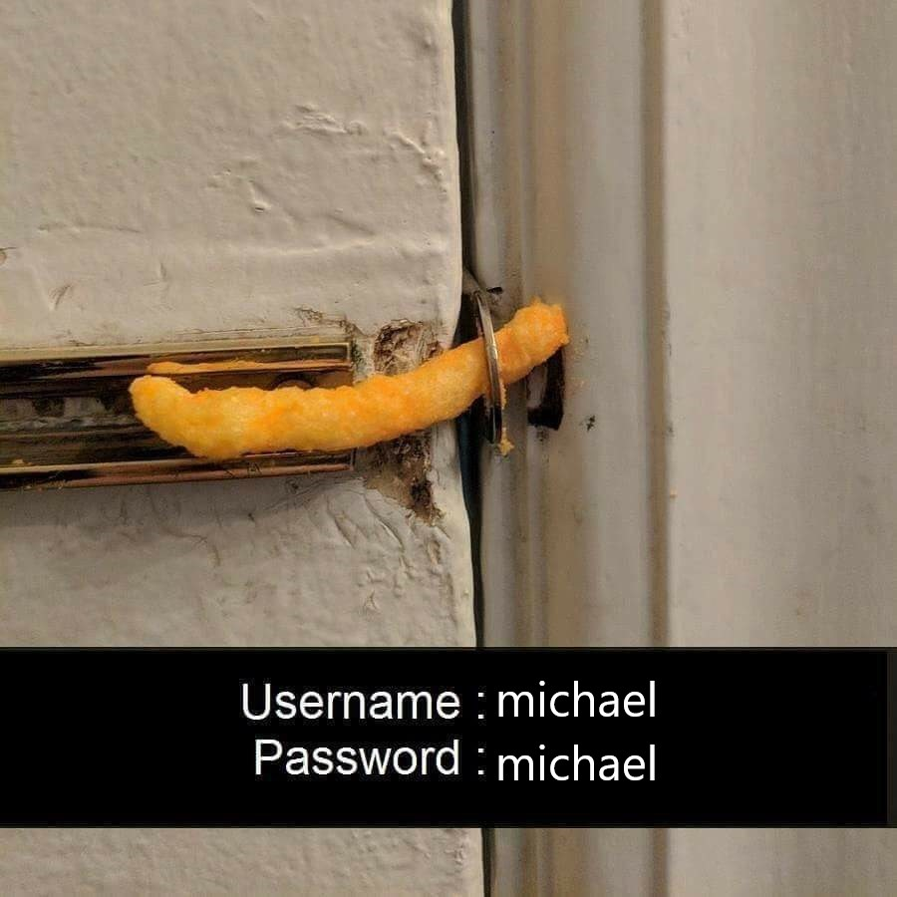
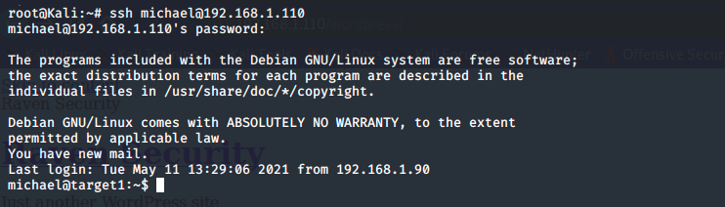
Exploitation: Weak Passwords
By guessing, we were able to determine that Michael’s password was michael
This allowed us to SSH into the server

Slide 11
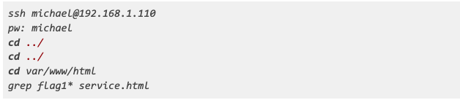
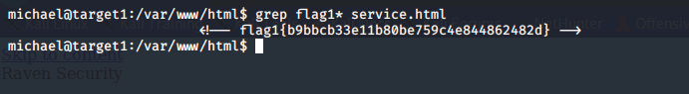
Finding Flag 1
Through some searching we were able to find flag1 within the services.html file on the target host.

Slide 12
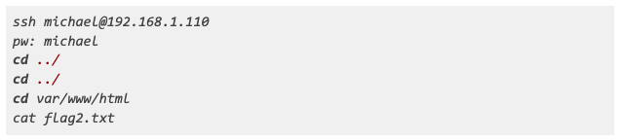
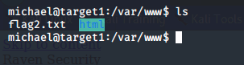
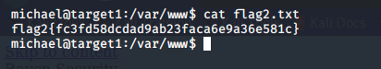
Finding Flag 2
In /var/www we found flag2.txt

Slide 13
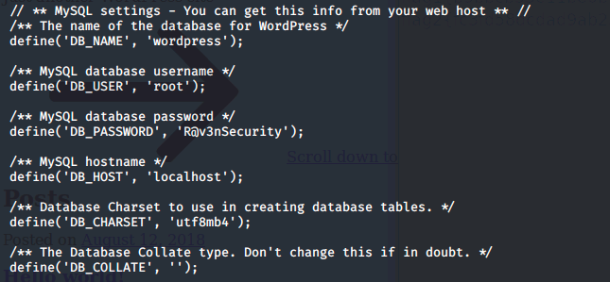
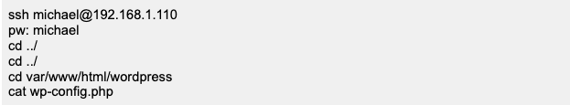
Exploitation: Poor Security Practices
Through deeper searching we were able to find plaintext passwords to the company MySQL database.
Ex. Michael Michael or cached passwords such as R@v3nSecurity.

Slide 14
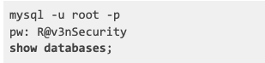
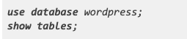
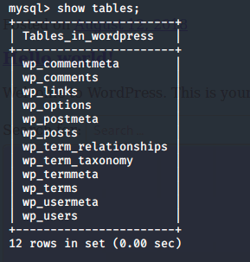
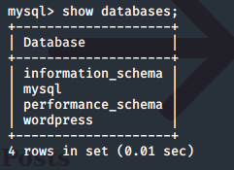
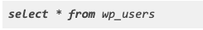
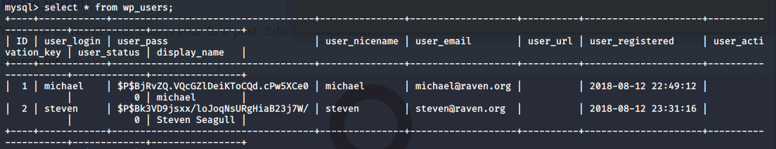
Exploitation: Poor Security Practices
Knowing the usernames and passwords to the database we were able to login to the instance and exfiltrate more data including password hashes.

Slide 15
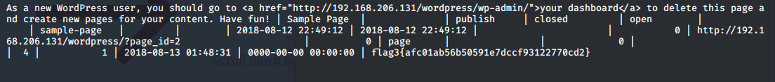
Exploitation: Password Hashes in Wordpress Database
The company stored their hashed passwords within their wordpress database which allowed us to get the passwords, and crack them, which lead us to finding Steven’s password.
select * from wp_users
select * from wp_posts
nano wp_hashes.txt Insert the hashes as follows #user:passwordhash john wp_hashes.txt

Slide 16

Finding Flag 3
Through searching the MySQL database we were able to find flag 3 with in wp_posts

Slide 17
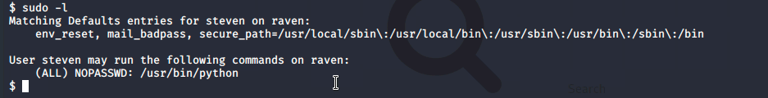

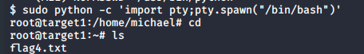
Exploitation: Python Privilege Escalation
Steven had sudo privileges with python, and because of that, we were able to escalate from a standard user to root.
su steven pw: pink84 sudo -l
Sudo python -c ‘import pty;pty.spawn(“/bin/bash”)’

Slide 18
Alerts Implemented
18

Slide 19
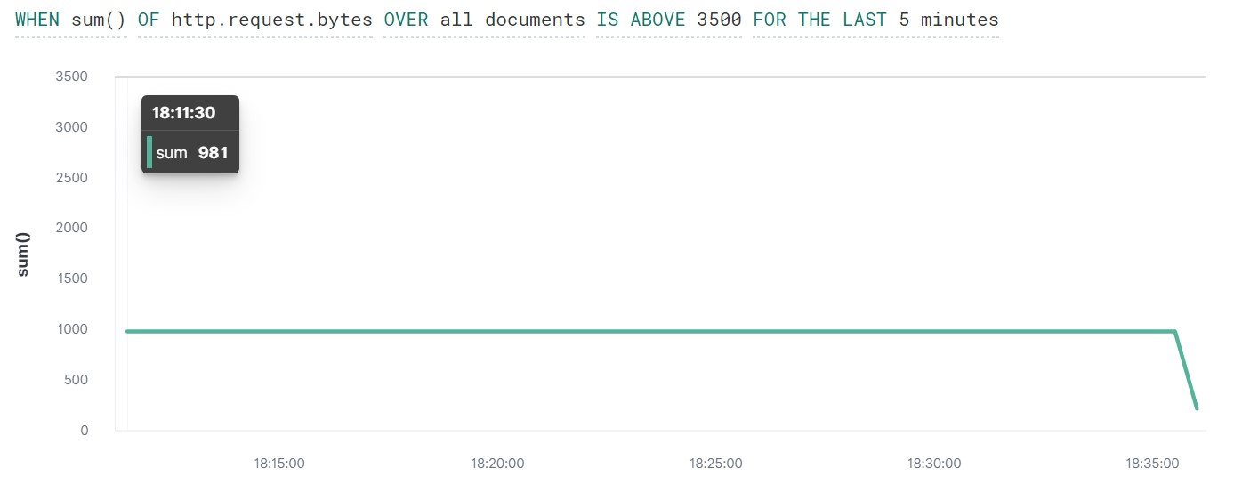
HTTP Request Size Monitor
Metric Monitored: WHEN sum () of http.request.bytes OVER all documents
Threshold:Triggers when the sum of HTTP is above 3500 for the last 1 minute

Slide 20
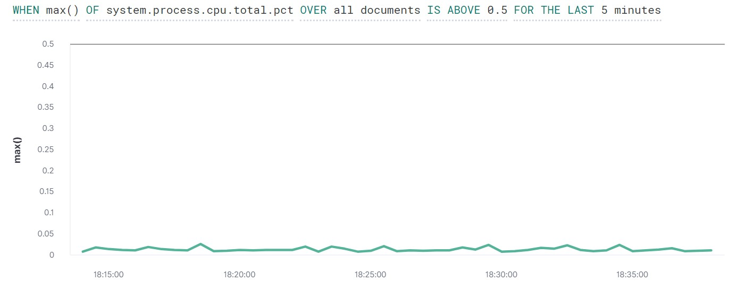
CPU Usage Monitor
Metric Used: WHEN max () OF system.process.cpu.total.pct OVER all documents
Threshold: was set to trigger when percentage of CPU exceed 50%

Slide 21
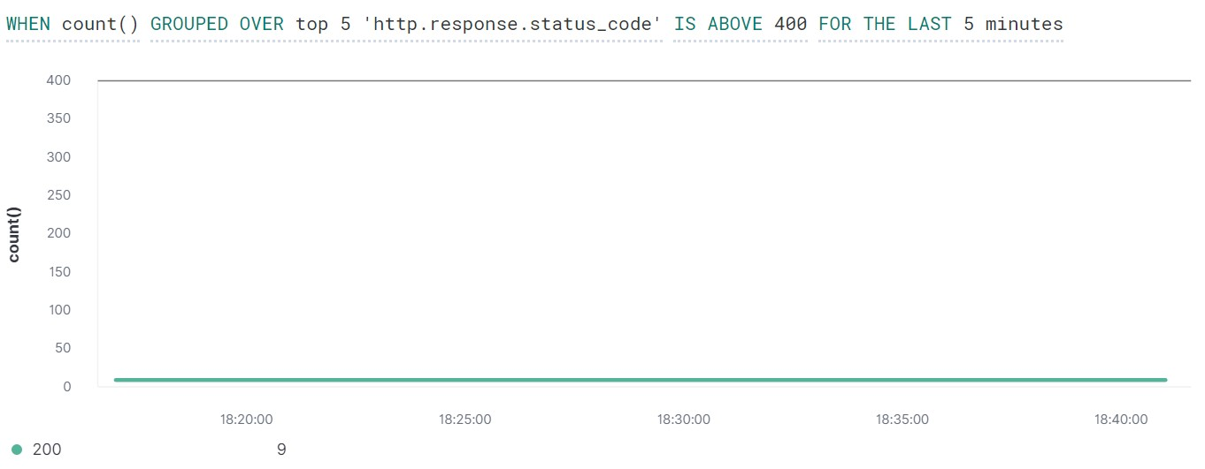
Excessive HTTP Errors
Metric Used: WHEN count () GROUPED OVER top 5 ‘http.response.status_code’
Threshold:Triggers when the top 5 http status codes exceed 400 in the last 5 minutes

Slide 22
Malicious Network Activity
22

Slide 23
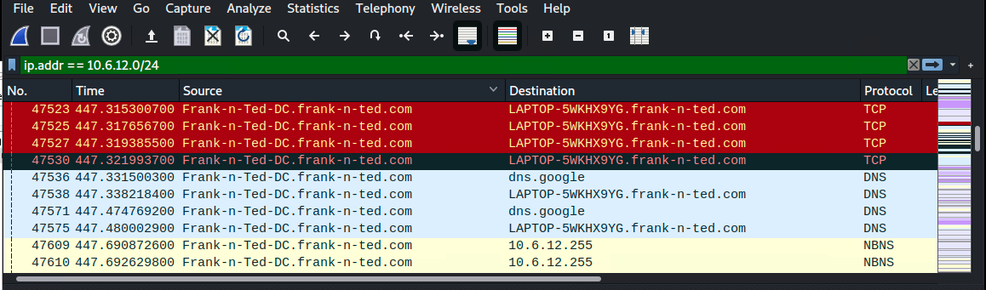
Time Thieves
What is the domain name of the users custom site?
frank-n-ted.com

Slide 24
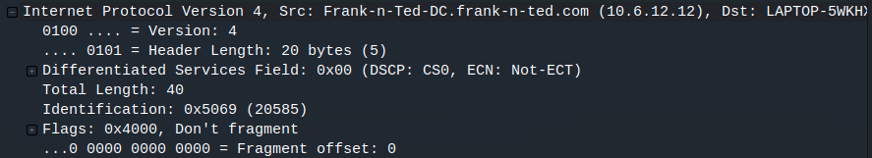
Time Thieves
What is the IP address of the Domain Controller (DC) of the AD network?
10.6.12.12

Slide 25
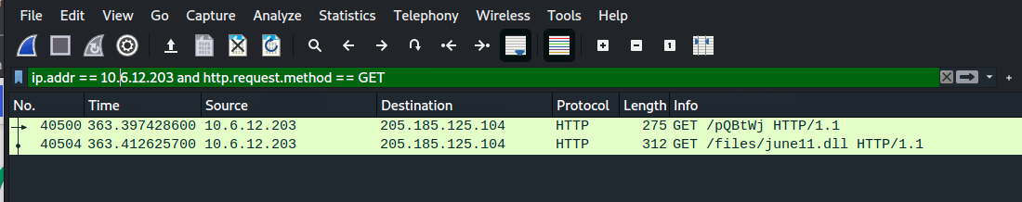
Time Thieves
What is the the name of the malware downloaded?
/files/june11.dll

Slide 26
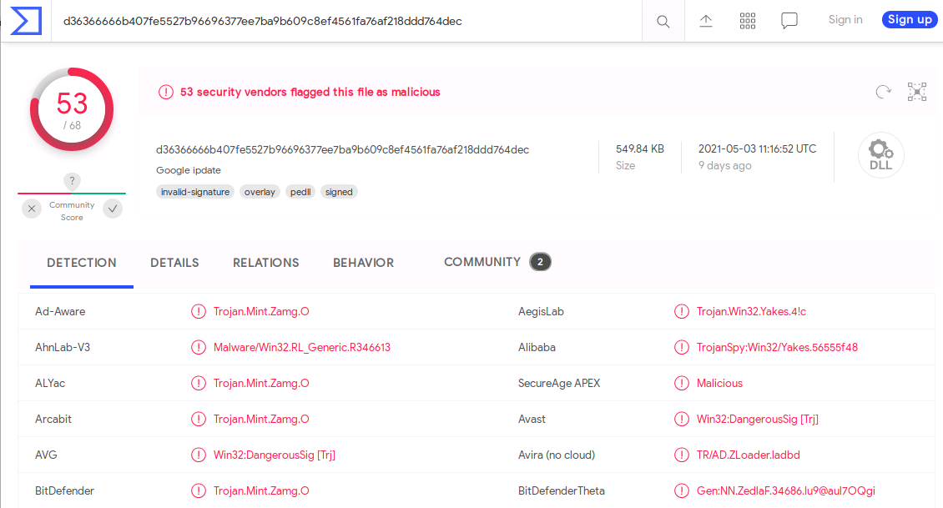
Time Thieves
What kind of malware is this classified as?
This was classified as a Trojan virus. Alerting on 53 out of 68 flags.

Slide 27
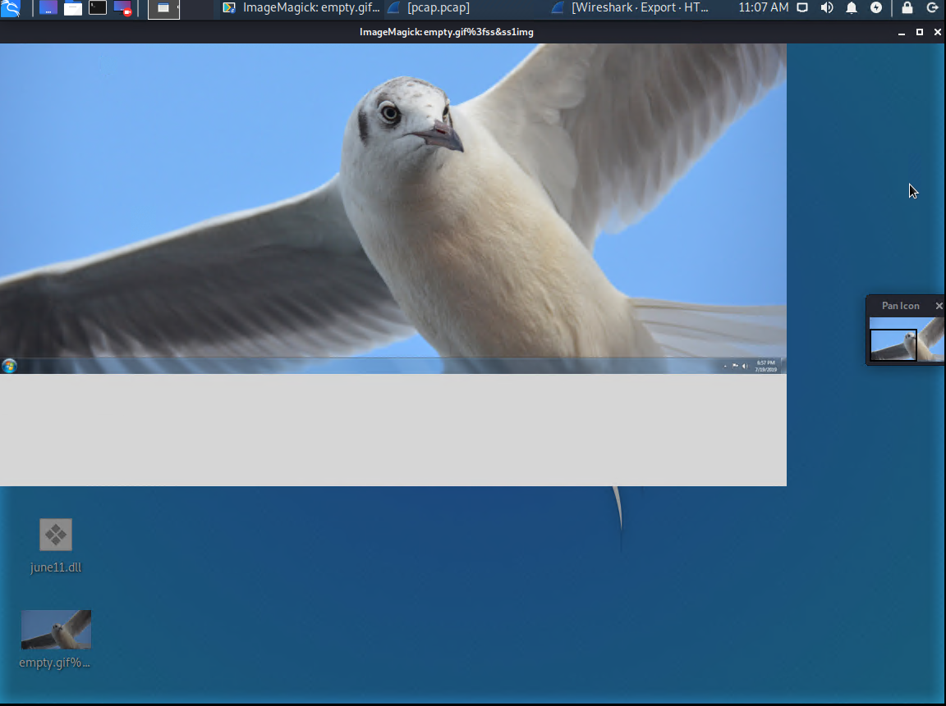
Vulnerable Windows Machines
Hostname: ROTTERDAM-PC$ / IP Address : 172.16.4.205 / MAC Address : 00:59:07:b0:a4
The most common protocols used : TLSv1.3 , TCP, HTTP
User was browsing the site mysocalledchaos.com quite often, was clicking on a fakeurl various times and as shown below in interesting files were browsing for background via green.mattingsolutions.co
Interesting files :
Hostname b5689023.green.mattingsolutions.co downloaded the desktop background file of empty.gif?ss&ss1img
Hostname IP 205.185.125.104 downloaded the june11.dll virus onto the host.

Slide 28
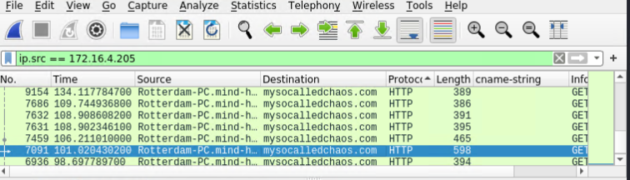
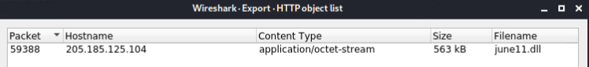
Vulnerable Windows Machines
Here we can see Rotterdam searching for http://mysocalledchaos.com
Below is the ‘june11.dll’ file that was downloaded that contained a virus.

Slide 29
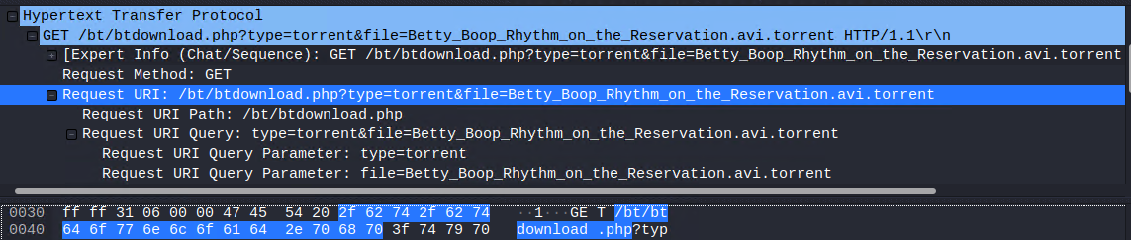
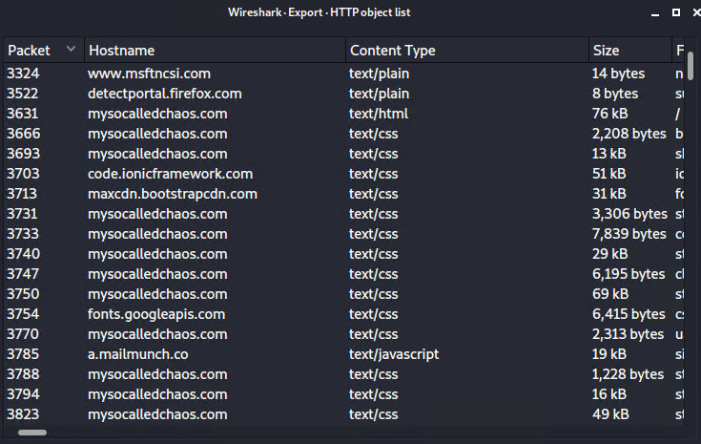
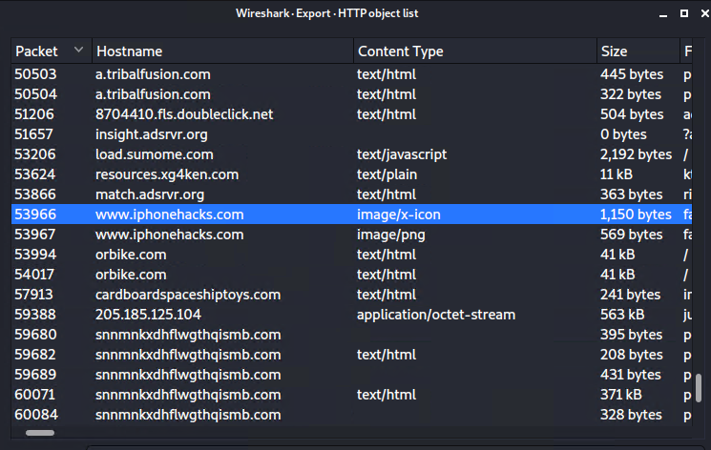
Illegal Downloads
The user operating on ip 10.0.0.201 was using company time to download
and stream movies and other files. They would spend time reviewing
personal information, visiting toy sites or guides on how to jailbreak an Iphone.

Slide 30
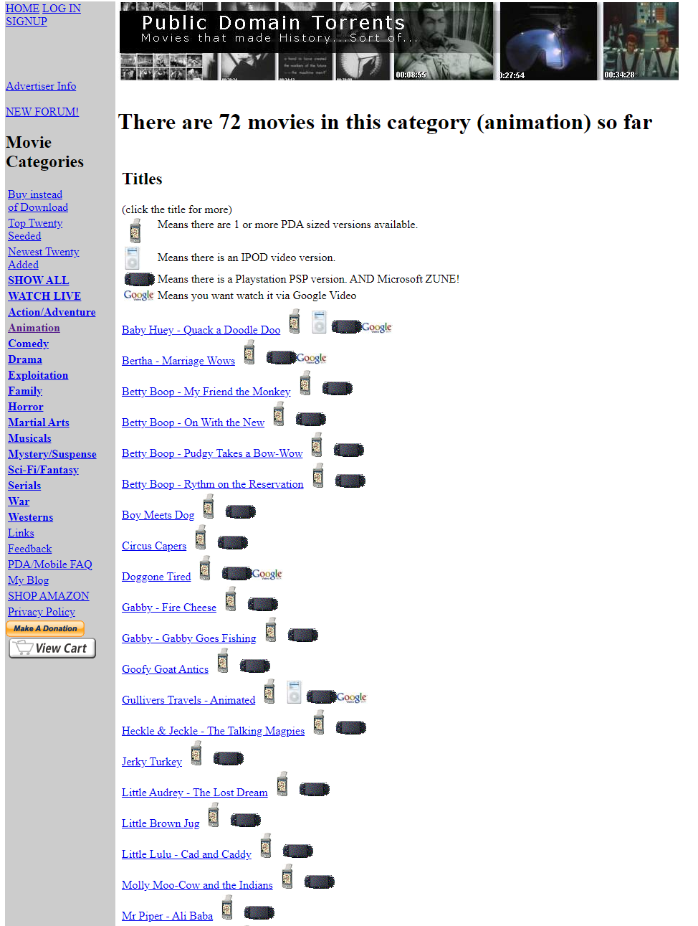
Illegal Downloads
Cont.
We were able to determine that the user downloaded the movie: Betty_Boop_Rythm_on_the_Reservation.
From that, we were also able to determine that they were using the website: http://publicdomaintorrents.info under the Animation category.

